Slide 1
FINAL PROJECTS
COMPUTER INFORMATION TECNOLOGY
CV RESUME
SPEARD SHEET
ANALISE

Slide 2
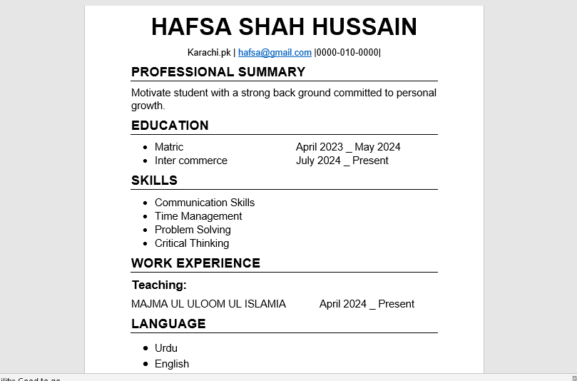
My Resume
Consists of five sections which includes my academic and professional details

Slide 3
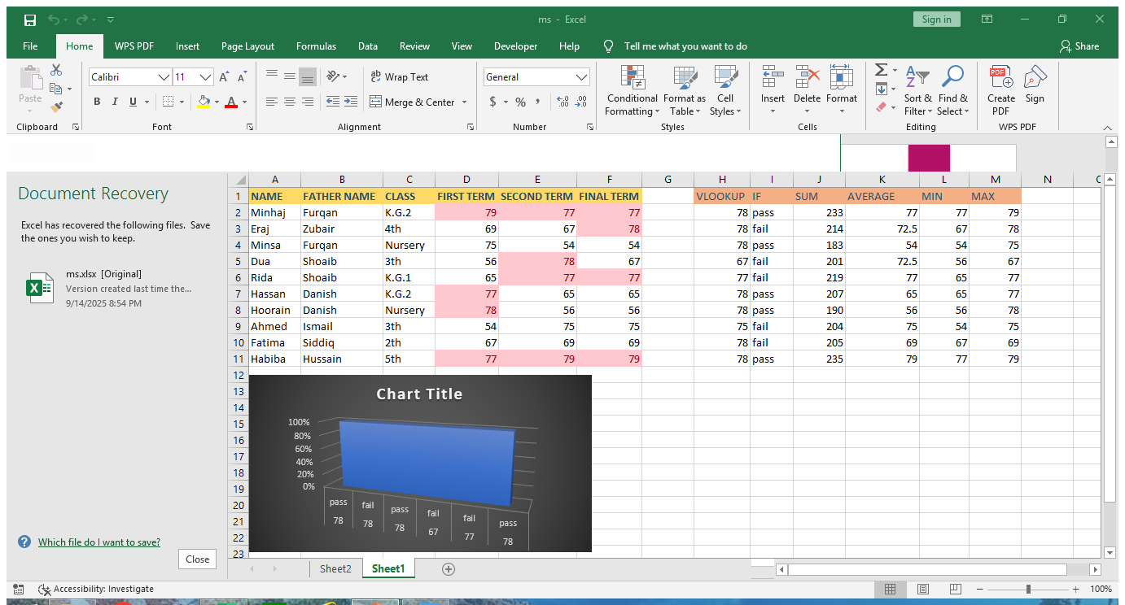
Conditional Formatting
IN EXCEL

Slide 4
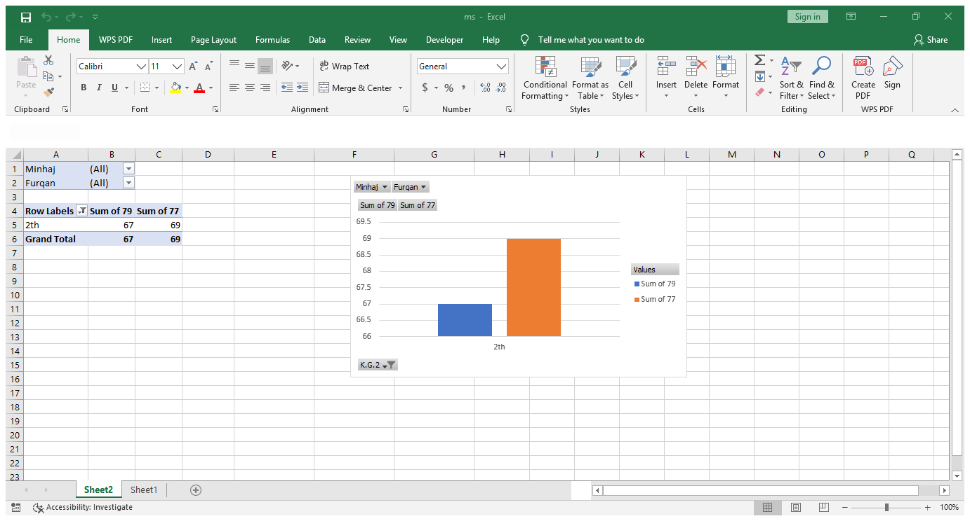
Pivot table in excel
I have created a pivot table in excel to sort and filter my data

Slide 5
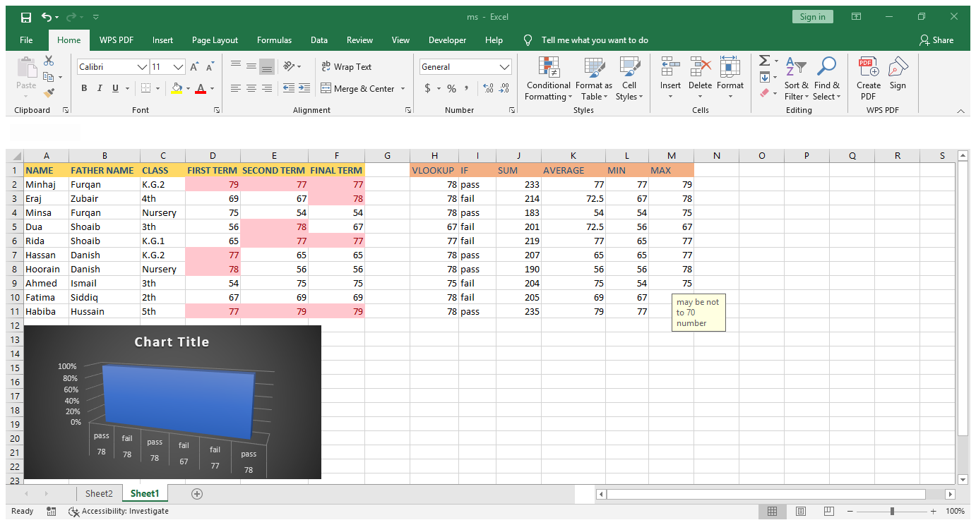
VLOOKUP in Excel
VLOOKUP in excel is used to lookup a certain value in any column

Slide 6
Data Validation
Here I have data validation and restricted to only enter a number between 1 to 70 and when he enters another number he gets an error

Slide 7
SUM in Excel
SUM ADD TO NUMBER

